Slide 1
TEFRA:
Annual Public Forum
11/17/21 PRESENTATION

Slide 2
Purpose of This Public Forum
TEFRA (The Tax Equity and Fiscal Responsibility Act) operates as a section 1115 demonstration waiver.
Federal waiver regulations require an annual public forum to solicit comments on the progress of the demonstration waiver.
Public will have an opportunity to provide comments.
Forum summary will be included in quarterly and annual reports to CMS.
11/17/21 PRESENTATION

Slide 3
TEFRA Overview
Medicaid program that helps families with children, younger than 19 years old, who have a disability and receive care in their homes rather than an institution.
The TEFRA program can help pay for the cost of those services for eligible children.
Families pay a premium on a sliding scale, depending on the parent/guardian’s income.
11/17/21 PRESENTATION
Notes:
The Tax Equity and Fiscal Responsibility Act (TEFRA) is a Medicaid program that can help families with children younger than 19 years old who have a disability receive care in their homes rather than an institution. The TEFRA program can help pay for the cost of those services for eligible children. Some families will not have to pay anything as part of the program. Others pay a premium on a sliding scale, depending on their income. Children who live in an institution or receive extended care in an institution are not eligible for TEFRA.

Slide 4
Are We Eligible for TEFRA Coverage?
Approval for the TEFRA program is based these three criteria:
Financial Eligibility
Disability
Medical Necessity
11/17/21 PRESENTATION
Notes:
Based on

Slide 5
Disability Requirement
Child must meet the Social Security Administration’s (SSA) definition of disabled.
If the child has received Supplemental Security Income (SSI) within one year prior to applying for TEFRA and continues to have the disability but lost the SSI benefits because of an increase in his or her parents’ income, the child may still qualify for TEFRA.
11/17/21 PRESENTATION
Notes:
A child must meet the Social Security Administration’s (SSA) definition of disabled. If the child has received Supplemental Security Income (SSI) within one year prior to applying for TEFRA and continues to have the disability but lost the SSI benefits because of an increase in his or her parents’ income, then a child may still qualify for TEFRA.

Slide 6
Disability Requirement
If SSA has not established a disability, then the Medical Review Team (MRT) will review the child’s medical records to establish whether the child has a disability.
Disability determinations are made by using the Social Security Administrations guidelines.
MRT requests a form asking to identify the child’s physician and other health care providers.
MRT reviews medical records provided by the child’s health care providers to make the disability decision.
11/17/21 PRESENTATION
Notes:
If SSA has not established a disability, then a Medical Review Team will review your child’s medical records to establish whether your child has a disability. In the application packet for TEFRA, there is a form that asks you to identify your child’s physician and other providers and give the Arkansas Department of Human Services authority to request your child’s medical records. DHS has doctors on staff who review medical records provided by your physician to make the disability determination.

Slide 7
Medical Necessity and Appropriateness of Care Requirement
The child must have a medical condition that would require institutional placement.
Medical necessity is also based on services that improve or maintain a child’s health or prevent a child’s health from getting worse.
11/17/21 PRESENTATION
Notes:
The child must have a medical condition that would require institutional placement in a hospital, a skilled nursing facility, an Intermediate Care Facility for Individuals with Intellectual Disabilities (ICF/IID), an Alternative Home placement, or be at risk for future institutional placement. Medical necessity is also based on services that improve or maintain a child’s health or prevent a child’s health from getting worse.

Slide 8
Medical Necessity and Appropriateness of Care Requirement
After the child is determined disabled, the TEFRA Committee then determines what appropriate medical services need to be provided and if those would be available to the child in the home.
Estimated cost of the care cannot exceed the estimated cost of care for the child in an institution.
11/17/21 PRESENTATION
Notes:
The Medical Review Team will also determine what appropriate medical services need to be provided and if those would be available to your child in the home. The estimated cost of the care cannot exceed the estimated cost of care for the child in an institution.

Slide 9
Financial Requirement
Child cannot have personal income that exceeds the Long-Term Care Medicaid limit of $2,382.
Child cannot have countable resources that exceed $2,000.
Parent/guardian’s income and resources are not used to determine financial eligibility of the child.
11/17/21 PRESENTATION
Notes:
The child cannot have personal income that exceeds the Long-Term Care Medicaid limit, which is three times the SSI income limit and can change each year. The child cannot have countable resources that exceed $2,000. Countable resources for a child include cash on hand, bank accounts, vehicles, etc. Parental income and resources are not considered.

Slide 10
2020 TERFRA Enrollment Summary
In 2020, there were a total of
6,155 TEFRA Enrollees.
11/17/21 PRESENTATION
Notes:
Based on

Slide 11
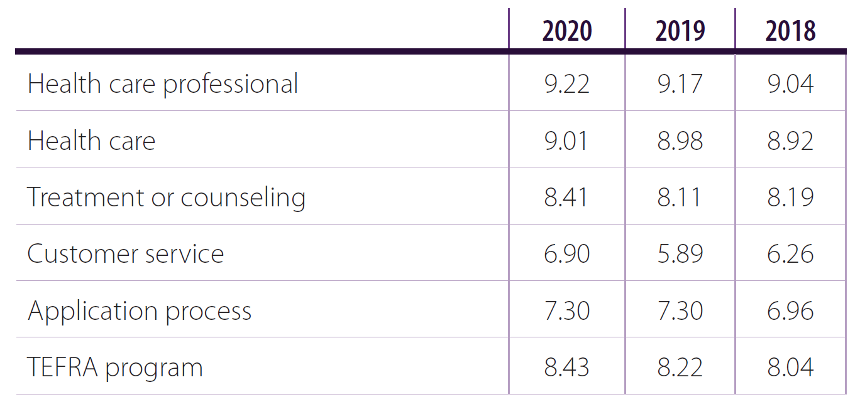
Health Care Quality, Outcomes and Access
Participants were asked to rate their satisfaction with the following on a scale from 0 (“worst possible”) to 10 (“best possible”).
11/17/21 PRESENTATION
Notes:
Every year, one of our contracted Vendors, AFMC (Arkansas Foundation for Medical Care) sends out a Beneficiary Satisfaction Survey.
AFMC received surveys from 537 clients before the cutoff date of Dec. 1, 2020
533 were eligible for analysis, resulting in a final analyzable response rate of 33%.

Slide 12
TEFRA Changes
Reduced the initial TEFRA payment requirement from two months to one month of premium.
Removed the quarterly invoicing option/process and require all invoices to be monthly.
Updated invoices and notices to include additional contact information.
Distributed a one-time letter to all guardians explaining the invoicing process changes.
Sending new letter to guardians when a premium changes due to the annual income review.
Created a TEFRA account summary notice that can be sent to a guardian upon request.
Updated the TEFRA invoices to make them more user friendly.
11/17/21 PRESENTATION

Slide 13
How do I contact TEFRA?
General TEFRA Information?
TEFRA Payment Information?
Application Status and Eligibility?
Medical Claim Status?
11/17/21 PRESENTATION

Slide 14
General TEFRA Information
800-482-5431 or
800-482-8988
General TEFRA Information can be provided through AFMC.
1-855-372-1084
11/17/21 PRESENTATION

Slide 15
TEFRA Payment Unit
If you have TEFRA billing or invoice questions, please call the TEFRA Premium Unit at 1-866-239-9938.
11/17/21 PRESENTATION

Slide 16
Application Status and Eligibility
https://humanservices.arkansas.gov/divisions-shared-services/medical-services/healthcare-programs/tefra/tefra-important-phone-numbers/
Access.arkanas.gov, log into your account and review your child’s application status online.
11/17/21 PRESENTATION

Slide 17
Medical Claim Status
800-482-5431 or
800-482-8988
Medical Claim Status for members or providers can be provided by AFMC.
11/17/21 PRESENTATION

Slide 18
Comments and Questions
Comments and questions can be:
Submitted to hilton.taylor@dhs.Arkansas.gov or
Mailed to Hilton Taylor, Jr., Arkansas Department of Human Services, Division of Medical Services, 700 Main Street, Little Rock, AR 72203
or
Expressed during the public comment portion of this meeting
11/17/21 PRESENTATION
Notes:
Based on

Slide 19
Public Comment
We want to hear from you!
11/17/21 PRESENTATION

Slide 20
Contact Us
Hilton Taylor, Jr.
hilton.taylor@dhs.Arkansas.gov
11/17/21 PRESENTATION

Slide 21


We Care. We Act. We Change Lives.
11/17/21 PRESENTATION

