Slide 1
Module 4: Crediting Handbook for the Child and Adult Care Food Program
The 5 Creditable Components
USDA is an equal opportunity provider, employer, and lender.

Slide 2
Goal of USDA’s Child & Adult Care Food Program:
To improve the health and nutrition of children and adults in the program while promoting the development of good eating habits through nutrition education.

Slide 3
Creditable Food in the CACFP
Grains, Fruits, Vegetables, Dairy &
Meat/Meat Alternates
Notes:
Creditible Food means it meets requirement of the CACFP program according to the USDA standards

Slide 4
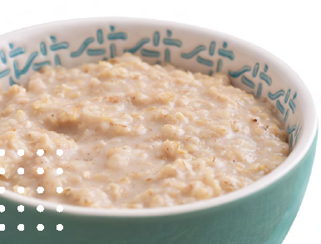
GRAINS

Slide 5
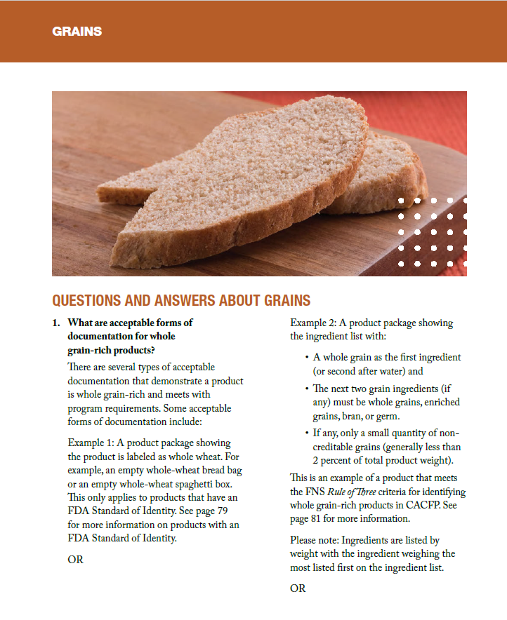
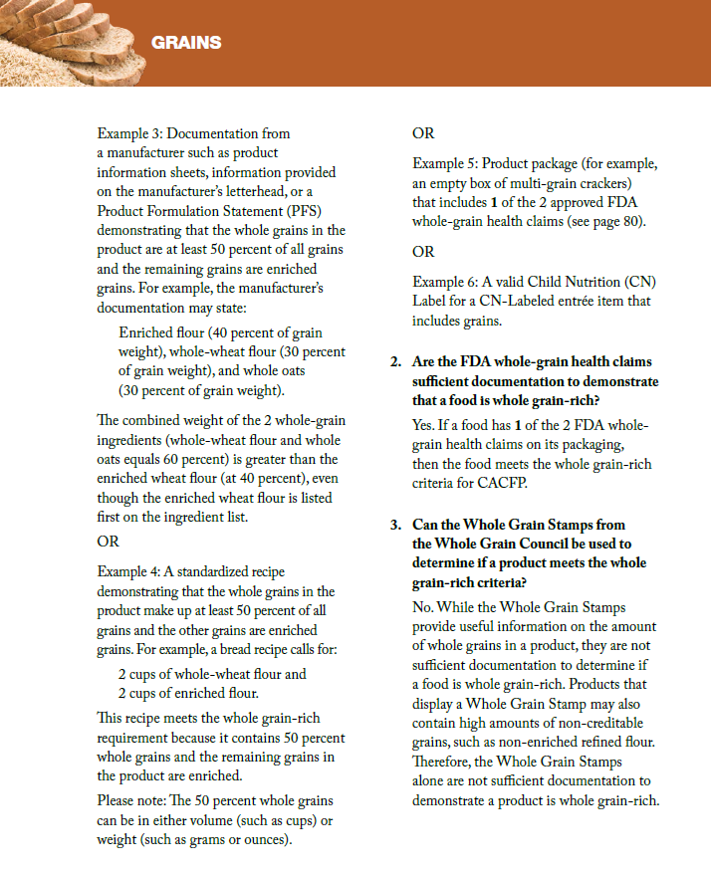

Slide 6
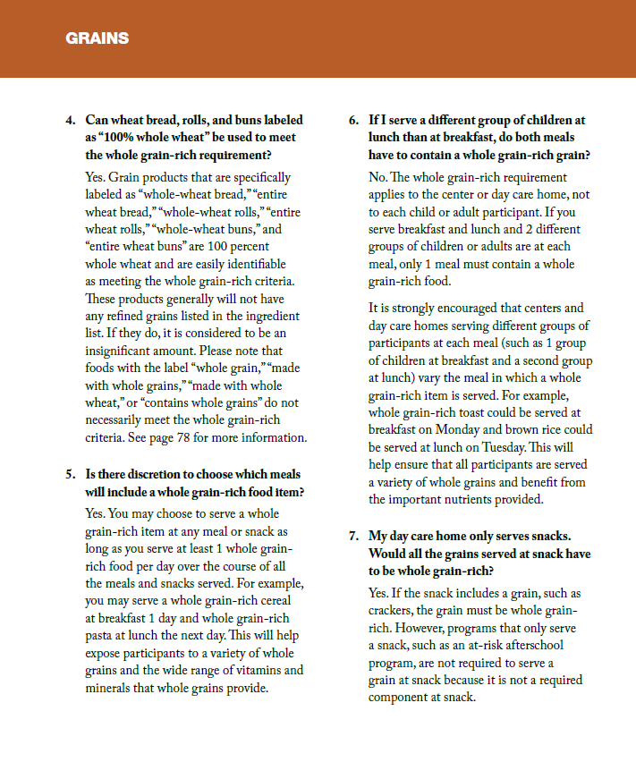
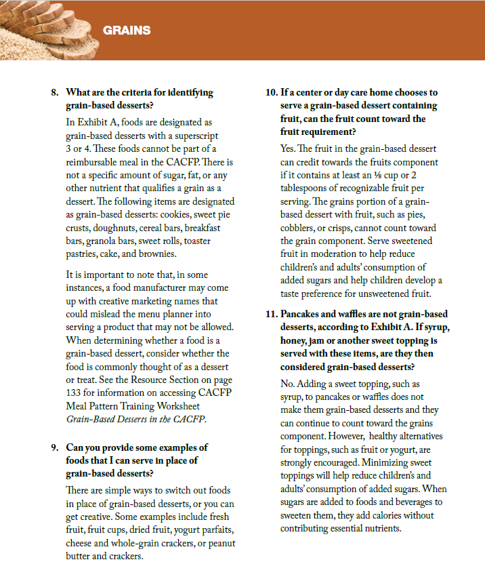

Slide 7
Rule of 3 Method: How will you determine if your product is whole grain rich? You will need to look at the nutrition label and list of ingredients:
1. The first ingredient (or second after water) in the food is whole grain
2. The second grain ingredient (if any) is a whole grain, enriched, bran, or germ.
3. The third grain ingredient (if any) is also a whole grain, enriched, bran, or germ.
Ignore derivatives and less than 2% grains
AND
AND
What to Watch Out For: The term “made with whole grain” “multi-grain” stamped on the package cannot be used to identify a whole grain-rich food. You must look at the ingredients on the label.
Notes:
To meet the Rule of Three criteria: The first ingredient (or the second ingredient after water) must be whole grain, and the next 2 grain ingredients (if any) must be whole grains, enriched grains, bran, or germ. Grain derivatives (byproducts of grains) do not count as grain ingredients and can be ignored when evaluating with the Rule of Three criteria. For more information on grain derivatives, see page 78. • Any non-creditable grain ingredients that are labeled as “less than 2 percent” in the ingredients list are considered insignificant and may be ignored. See page 85 for list of non-creditable grains or flours

Slide 8
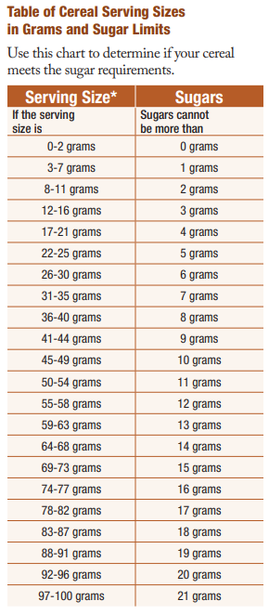
Table of Serving Sizes
All grains must be documented from grams to ounces as of October 1, 2021.
Cereals may contain no more than 6 grams of sugar per dry ounce.
Resources are available in the resources section to assist in converting grains from grams to ounces.

Slide 9
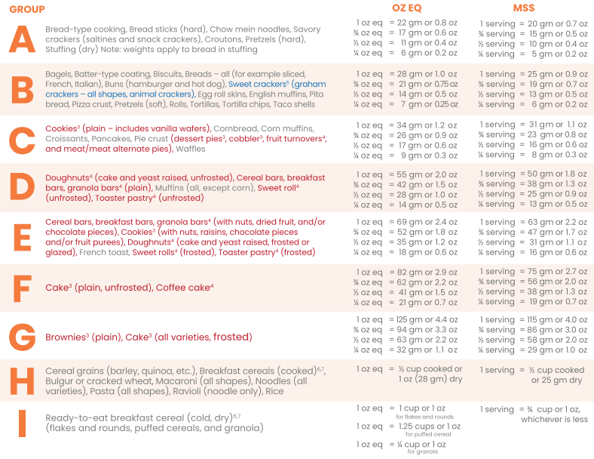
Black: Creditable for CACFP, NSLP, & SFSP
Red: Not Creditable for CACFP
Blue: Reinstated as creditable item for CACFP

Slide 10
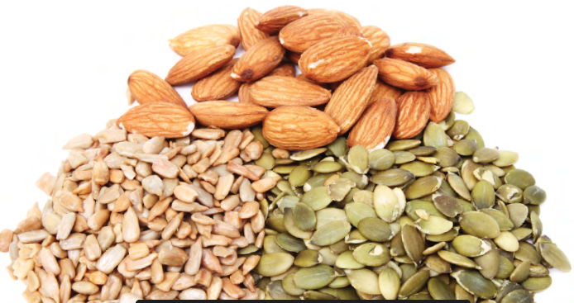
Meats/ Meat Alternates

Slide 11
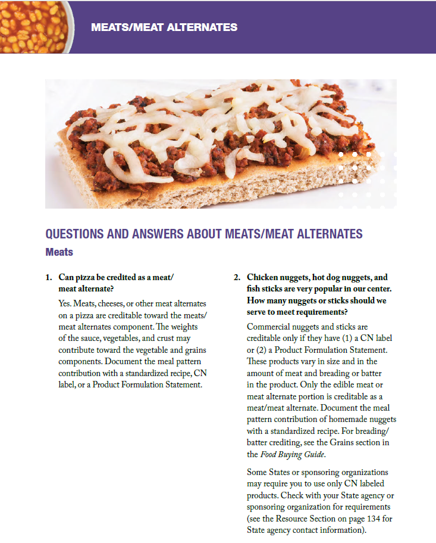
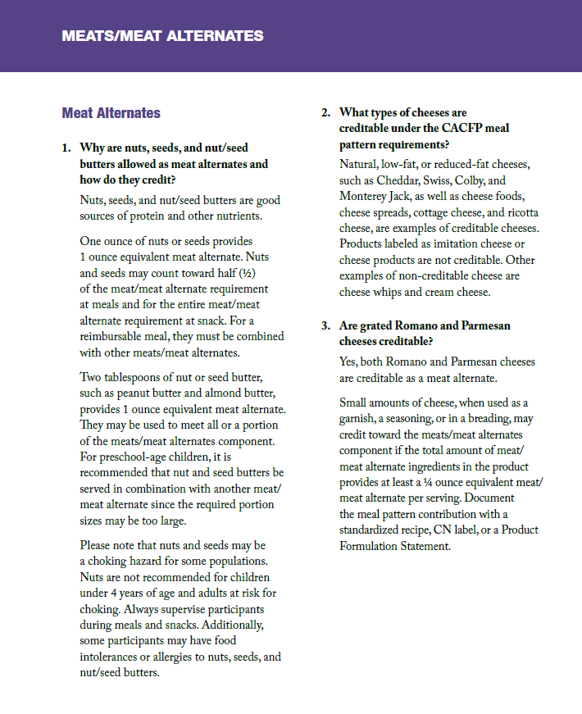

Slide 12
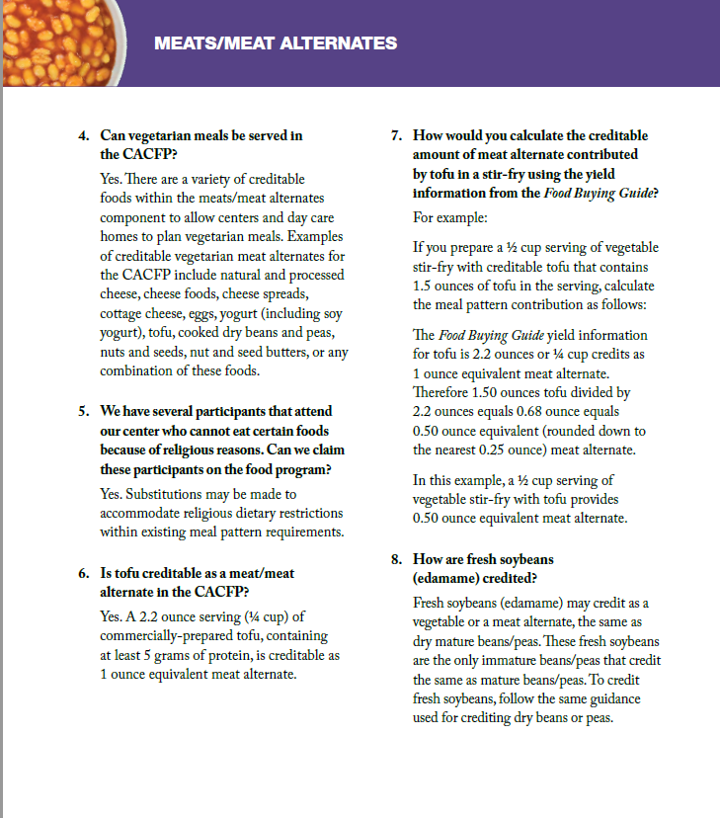
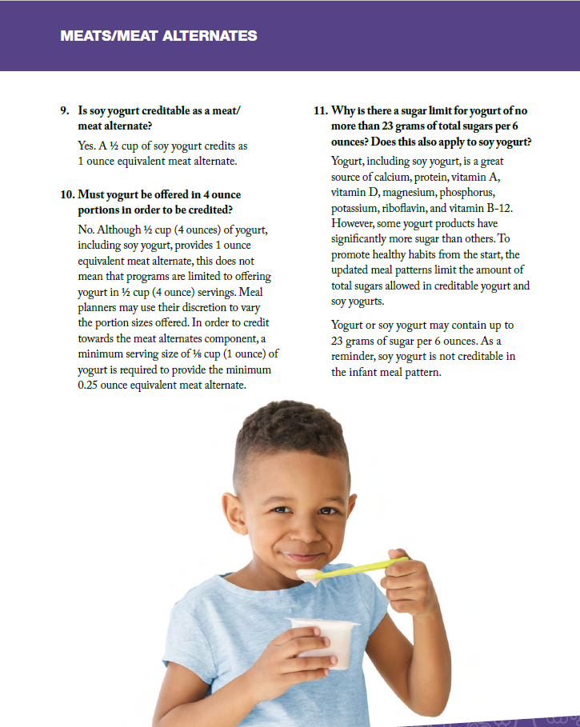

Slide 13
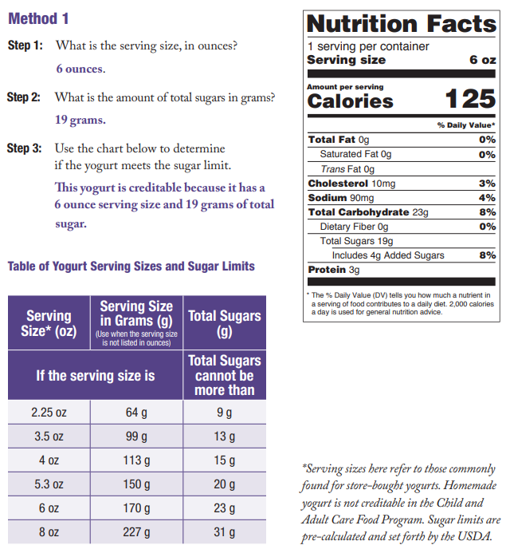
Yogurt must contain no more than 23 grams of sugar per
6 ounces.

Slide 14
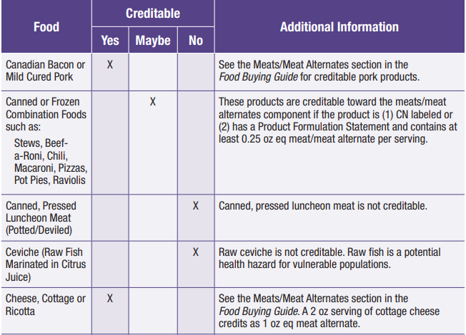
Columns are used to identify is an item is
Creditable
Non-creditable, or
Creditable under specific circumstances.
i.e. – canned or frozen combination foods

Slide 15
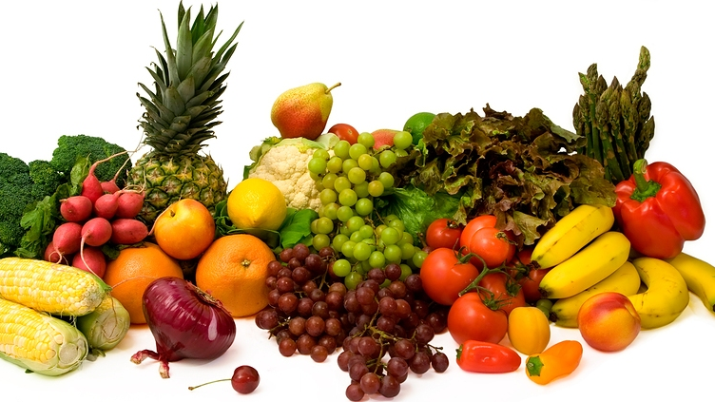
FRUITS & VEGETABLES

Slide 16
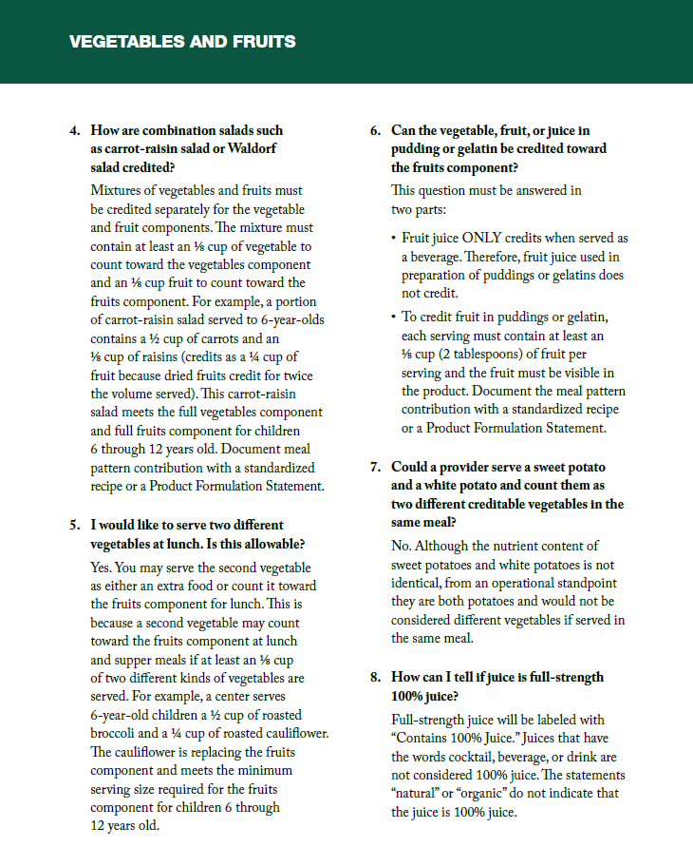

Slide 17
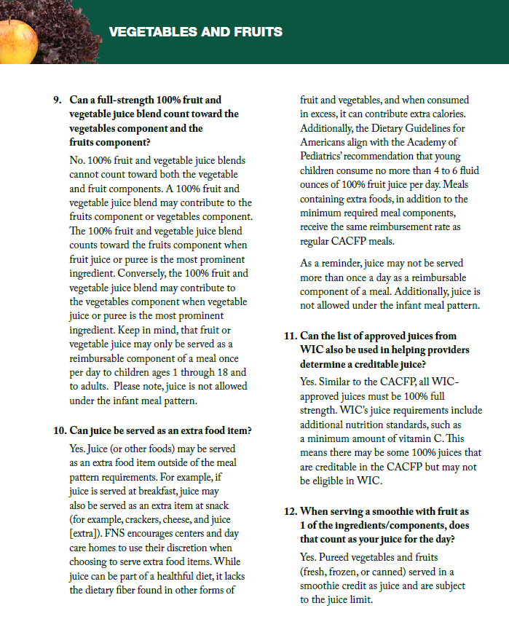
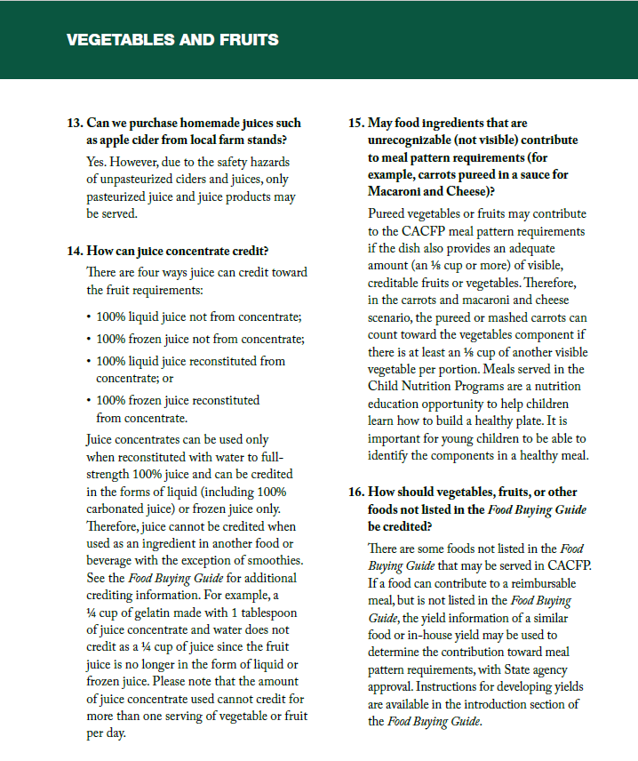

Slide 18
Vegetable and fruit basics
A vegetable can meet the entire fruit requirement at lunch and supper - such as green peas & carrots however you cannot serve two fruits at lunch/supper.
When more than one vegetable is served at lunch or supper, you must use two different types
Fruits may be served fresh, frozen, canned or dried
100% pasteurized fruit juice may only be served once per day but can be served every day of the week

Slide 19
DAIRY
Fluid Milk

Slide 20
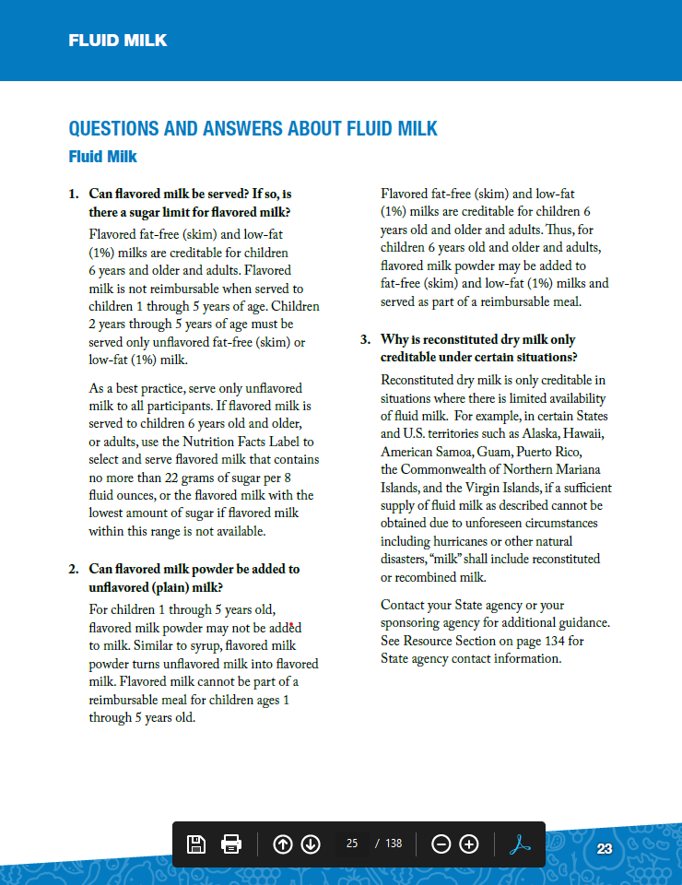
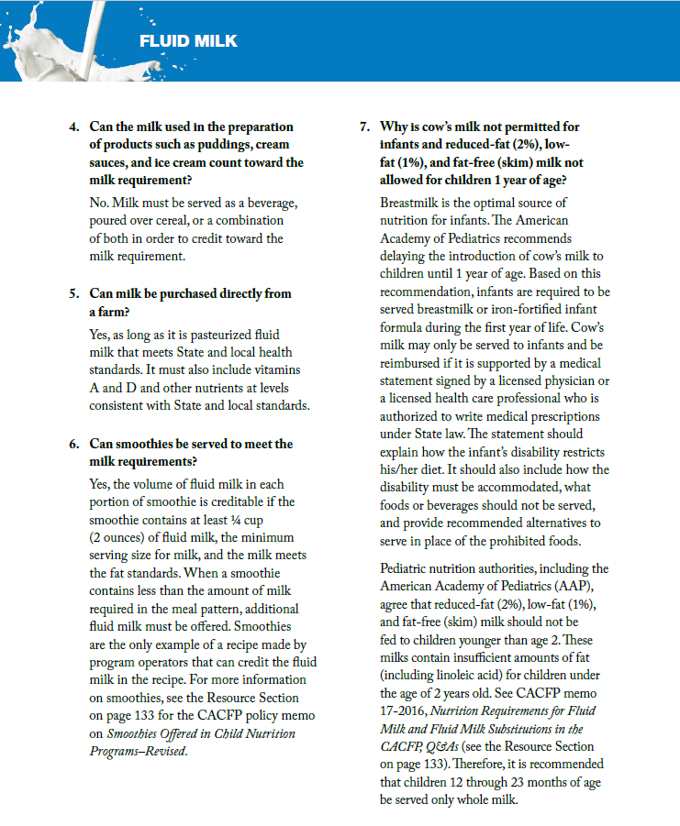

Slide 21
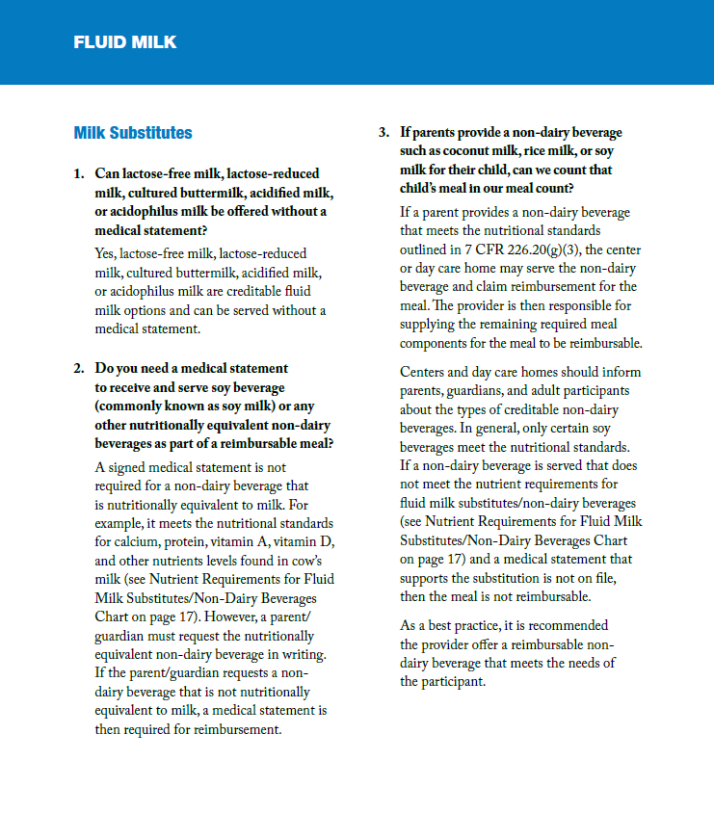
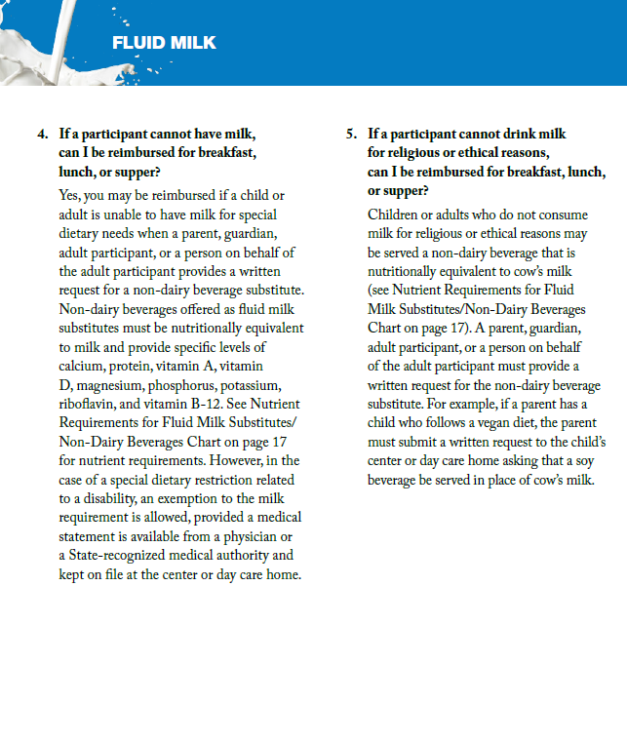

Slide 22
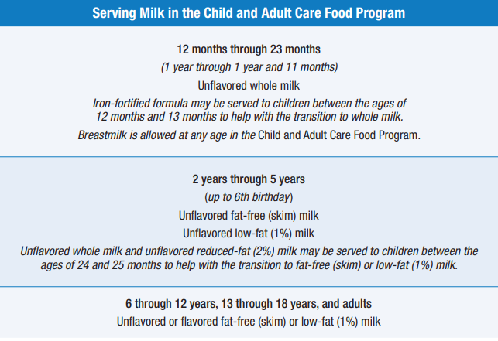
Creditable Milk
Note: Soy Milk is also creditable in CACFP
Notes:
Iron fortified infant formula or breastmilk – birth -11 months (Breastmilk may be served at any age in the CACFP program)
Whole milk – ages 1-2
1% low-fat milk or fat free (skim) milk - 2-18 and Adults
Lactose free and soy milk are nutritionally equivalent to cows milk. No medical statement is needed for substitution of these items. Flavored milk can only be served to children age 6 and older.
Yogurt may be served in place of milk once per day for adults only.

Slide 23
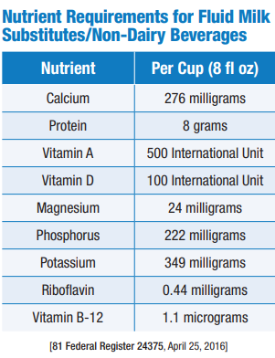
The CACFP requires that fluid milk substitutes be nutritionally equivalent to milk and meet the following nutritional standards (7 CFR 210.10(m)(3)).
A FINAL UDSA RULE addressed the substitution of fluid milk for children who’s non-disabling allergies, culture, religion, or ethical beliefs do not allow consumption of cows milk.
Parents may request in writing a fluid milk substitute
A Medical Exception Statement signed by a physician is NOT required for this type of request (mild substitution ONLY).

Slide 24
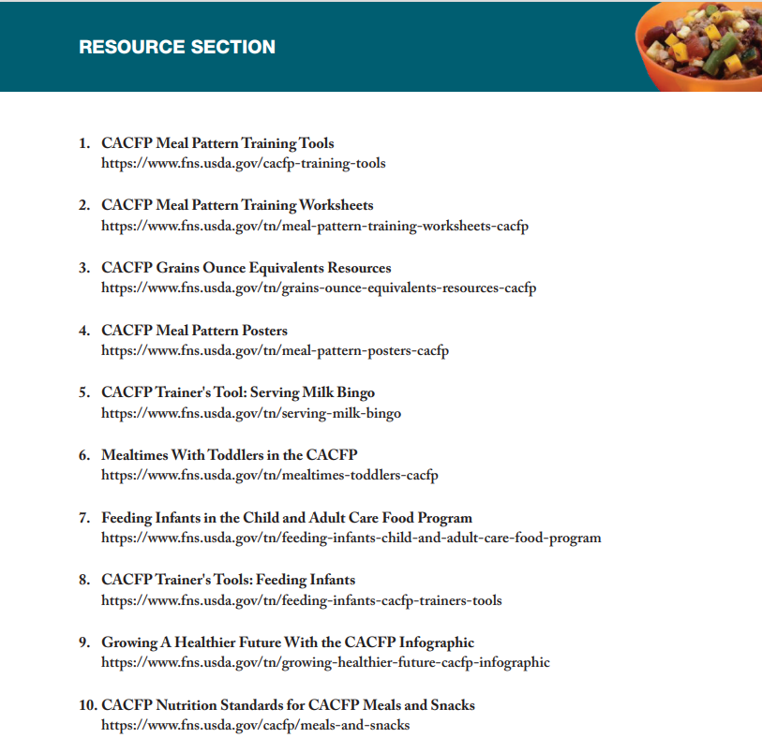
Resources Section

Slide 25
USDA Non-Discrimination Statement
In accordance with Federal civil rights law and U.S. Department of Agriculture (USDA) civil rights regulations and policies, the USDA, its Agencies, offices, and employees, and institutions participating in or administering USDA programs are prohibited from discriminating based on race, color, national origin, religion, sex, gender identity (including gender expression), sexual orientation, disability, age, marital status, family/parental status, income derived from a public assistance program, political beliefs, or reprisal or retaliation for prior civil rights activity, in any program or activity conducted or funded by USDA (not all bases apply to all programs). Remedies and complaint filing deadlines vary by program or incident.
Persons with disabilities who require alternative means of communication for program information (e.g., Braille, large print, audiotape, American Sign Language, etc.) should contact the responsible Agency or USDA's TARGET Center at (202) 720-2600 (voice and TTY) or contact USDA through the Federal Relay Service at (800) 877-8339. Additionally, program information may be made available in languages other than English.
To file a program discrimination complaint, complete the USDA Program Discrimination Complaint Form, AD-3027, found online at How to File a Program Discrimination Complaint and at any USDA office or write a letter addressed to USDA and provide in the letter all of the information requested in the form. To request a copy of the complaint form, call (866) 632-9992. Submit your completed form or letter to USDA by: (1) mail: U.S. Department of Agriculture, Office of the Assistant Secretary for Civil Rights, 1400 Independence Avenue, SW, Washington, D.C. 20250-9410; (2) fax: (202) 690-7442; or (3) email: program.intake@usda.gov.
USDA is an equal opportunity provider, employer, and lender.
Arkansas Special Nutrition Program Website:
https://dhs.arkansas.gov/dccece/snp/WelcomeSNPM.aspx

Slide 26
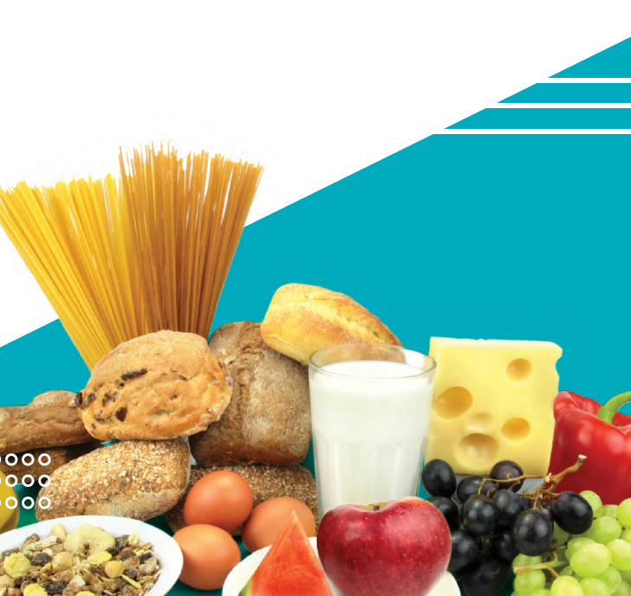
www.facebook.com/ArkDHS
@ARHumanServices
@arkansasdhs
Arkansas DHS
Social Media

